Slide 1
Activities in 2019 – 2021
Work packages:
QA GEM production: finish production, testing, documentation ⇒ done (03/2019)
Assembly of OROC2 components (spare components) ⇒ done (03/2019)
Test and calibration of IROCs and OROCs at CERN (GIF++, P2) ⇒ done (06/2019)
TPC disassembly & assembly, tests in clean room ⇒ interrupted (03/2020)
TPC software development:
  GEM amplification, ion backflow model in O2 ⇒ done (08/2019)
  Kr clustering ⇒ ongoing
  X-ray analysis ⇒ ongoing
Analysis: production of charmonia, exotics ⇒ started
Manpower:
BMBF: 38 + 10.5 PM (until 06/2021)
non-BMBF: 10 (Ball) + 3 (Ottnad) + 2 (Hoesgen) + 6 (6 students) (until now)

Slide 2
Ideas for future activities TPC
Implement and test Kr clustering (different variants)
Test pad-by-pad calibration with X-rays
Implement gain correction in O2
Develop & implement model for ion backdrift
Study and optimize dE/dx performance
Contributions to software quality, reconstruction?
Hardware activities? Chamber tests, optimize field configuration, power supply,…
Send manpower to CERN?

Slide 3
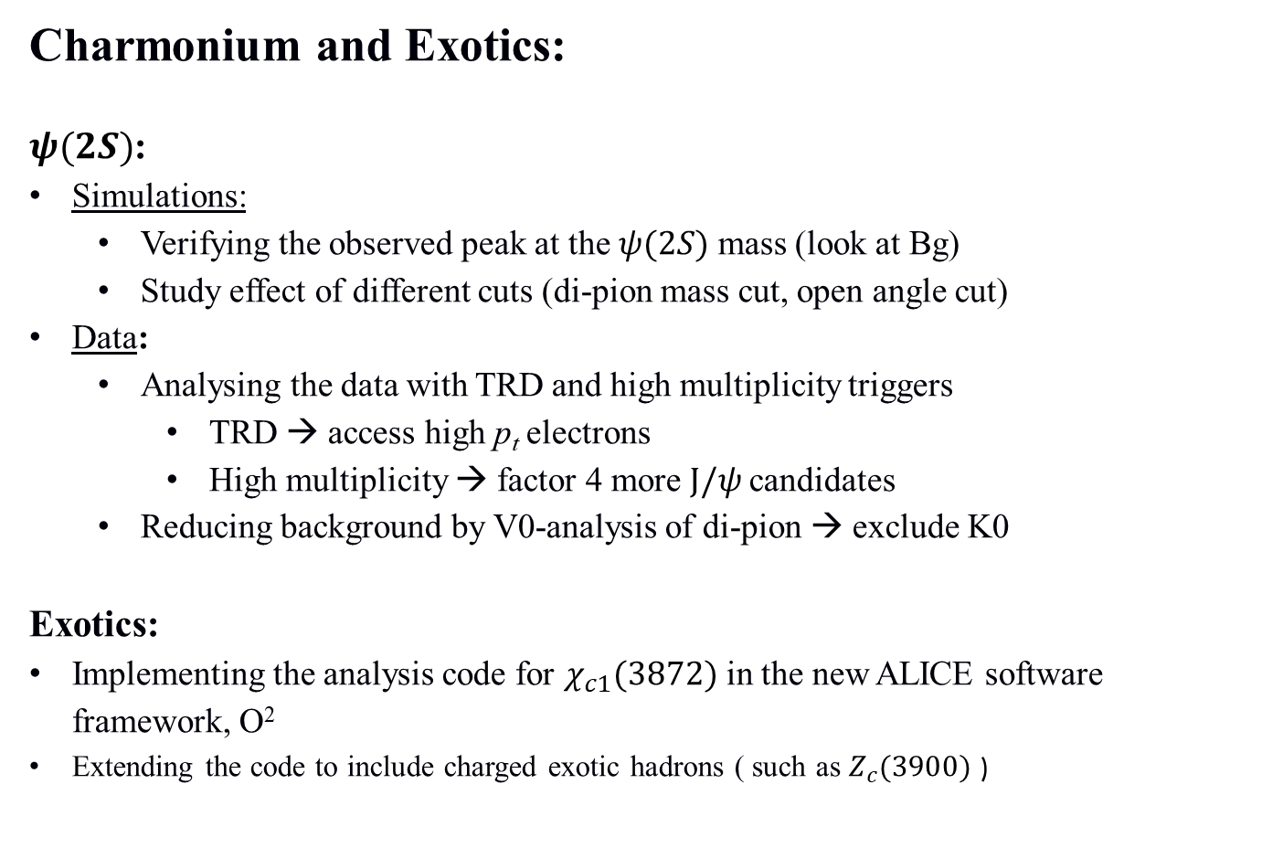
Future plans in data analysis (I)
Charmonium and Exotics:
$ψ(2S)$:
Simulations:
  Verifying the observed peak at the $ψ(2S)$ mass (look at Bg)
  Study effect of different cuts (di-pion mass cut, open angle cut)
Data:
  Analysing the data with TRD and high multiplicity triggers
    TRD → access high p_{t} electrons
    High multiplicity → factor 4 more $J/ψ$candidates
  Reducing background by V0-analysis of di-pion → exclude K0
Exotics:
Implementing the analysis code for $χ_{c1}(3872)$ in the new ALICE software framework, O²
Extending the code to include charged exotic hadrons ( such as $Z_{c}(3900)$ )

Slide 4
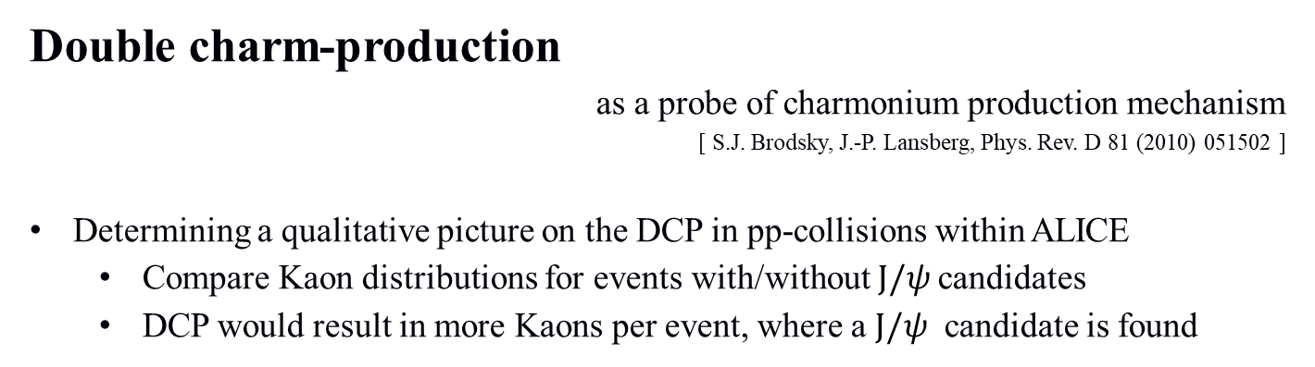
Future plans in data analysis (II)
Double charm-production
as a probe of charmonium production mechanism
[ S.J. Brodsky, J.-P. Lansberg, Phys. Rev. D 81 (2010) 051502 ]
Determining a qualitative picture on the DCP in pp-collisions within ALICE
  Compare Kaon distributions for events with/without $J/ψ$candidates
  DCP would result in more Kaons per event, where a $J/ψ$ candidate is found

